Slide 1
Continuous Assurance of Controls

Slide 2
Cloud Native Enterprise: Organising Framework within Regulatory\Corporate Governance Guidelines
Alignment with APRA Risk Management Guidelines – CPG 220
..
Cloud Services
Regulating Authority – 3 Lines of Defence Risk Mgt Model
Global Consumer
Governing Board \ Audit Committee
Senior Management
Economic Growth Opportunity
Line 3:
ASSURE
Line 2:
OVERSEE\SPECIALISE
Line 1:
OWN
APRA CPG 220 – Risk Management Guidelines
Page 3, section 6: The key principles maintain that:
Line 1 Business management cannot abrogate its responsibility for risk management, and
Clear separation of the roles and responsibilities of Line 1 and Line 2 must be upheld.
The Purpose of Business: Creating & Keeping a Customer

Slide 3
Cloud Native Enterprise: Organising Framework within Regulatory\Corporate Governance Guidelines
Alignment with APRA Risk Management Guidelines – CPG 220
..
Cloud Services
Regulating Authority – 3 Lines of Defence Risk Mgt Model
Global Consumer
Governing Board \ Audit Committee
Senior Management
Economic Growth Opportunity
Line 3:
ASSURE
Line 2:
OVERSEE\SPECIALISE
Line 1:
OWN
APRA CPG 220 – Risk Management Guidelines
Page 7, section 8: Risk Specialisation & Oversight:
The data and information captured as part of the risk management framework which are used in the decision-making processes within the business, in particular the completeness and appropriateness of the risk identification and analysis, ongoing effectiveness of risk controls, and prioritisation and management of action plans
The Purpose of Business: Creating & Keeping a Customer

Slide 4
Cloud Native Enterprise: Organising Framework within Regulatory\Corporate Governance Guidelines
Alignment with APRA Risk Management Guidelines – CPG 220
..
Cloud Services
Regulating Authority – 3 Lines of Defence Risk Mgt Model
Global Consumer
Governing Board \ Audit Committee
Senior Management
Economic Growth Opportunity
Line 3:
ASSURE
Line 2:
OVERSEE\SPECIALISE
Line 1:
OWN
APRA CPG 220 – Risk Management Guidelines
Page 8, section 11: Real-time & retrospective Automated Assurance:
In support of the annual independent review process
Continuous Observation over the Rigorous Management of Critical Enterprise Cloud State
The Purpose of Business: Creating & Keeping a Customer

Slide 5



Cloud Native Enterprise: Organising Framework within Regulatory\Corporate Governance Structure
Providing Access to Continuous Innovation At Scale Across Multi-Cloud
..
Continuous Innovation
Regulating Authority – Systemic Risk Management
Global Consumer
Governing Board \ Audit Committee
API Economy Innovation
Senior Management
Economic Growth Opportunity
Line 3:
ASSURE
Line 2:
OVERSEE\SPECIALISE
Line 1:
OWN
Continuous
Cloud
Innovation
EC Control Plane
The Purpose of Business: Creating & Keeping a Customer
Control Assurance
Fabric Control
Team Space
Tenant Space
Continuous
OSS (CNCF)
Innovation
EC Kernel
Secure Scaffold
Controls
Services
Public Clouds
AZR
AWS
GCP

Slide 6
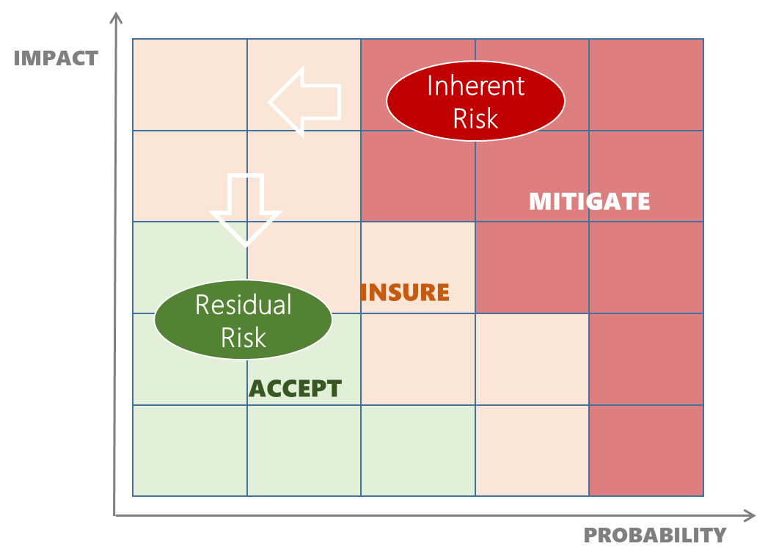
Assurance Objective: To Provide Access to a Continuous Stream of Cloud & OSS Innovation
HOW: By Specialising in Reducing Residual Risk & Providing a Consistent Line 1 Risk Decision Framework
Line 2 Responsibility – Oversee & Specialise in Risk Management
Line 1 Responsibility – Own & Manage Risk
Cloud SRE
Digital Portfolio\Product
Calculate Asset At Risk & Apply Residual Risk
Risk Decision Framework
Tenant Control Framework
Service Control Framework
Workspace Control Framework
Inherent Risk Definition
Public Cloud
Inherent Risk?
Continuous
OSS
Innovation
Continuous
Cloud
Innovation
Alignment with the APRA’s CPG 220 Risk Mgt
Residual Risk
Residual Risk
Residual Risk
TRA’s
Cloud GRC
Line 3 Responsibility – Assure Coverage & Effectiveness of Line 1 & Line 2 Responsibilities

Slide 7
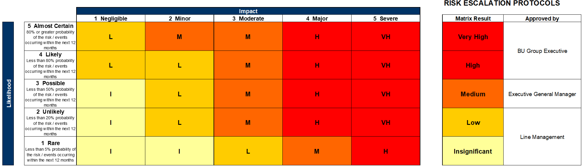
Assurance Objective: To Provide Access to a Continuous Stream of Cloud & OSS Innovation
HOW: By Specialising in Reducing Residual Risk & Providing a Consistent Line 1 Risk Decision Framework
Line 1 Responsibility – Own & Manage Risk
Digital Portfolio\Product
Accept
Calculate Asset At Risk & Apply Residual Risk
Risk Decision Framework
Insure
Public Cloud
Inherent Risk?
Mitigate
Risk Decision Implication
Continuous
OSS
Innovation
Continuous
Cloud
Innovation
A Single Risk Framework Applied Consistently across the Enterprise
Cloud GRC
Line 3 Responsibility – Assure Coverage & Effectiveness of Line 1 & Line 2 Responsibilities

Slide 8
Assurance Experience: Self Service Risk Decision Support
Line 1 Risk Decision Support that is Consistently applied across the Group (Line 2 Embedded Oversight)
Line 1 Responsibility – Own & Manage Risk
Digital Portfolio\Product
Calculate Asset At Risk & Apply Residual Risk
Workspace
Prod1
Data Privacy
P&C
Value At Risk
$20 – $50M
Public Cloud
Inherent Risk?
PROBABILITY
Continuous
OSS
Innovation
Workspace Control
Medium
Service Control
Low
Continuous
Cloud
Innovation
Alignment with:
Recommendation 9 in CBA Prudential Inquiry Final Report Page 30
Tenant Control
Insignificant
ASE
App GW
Redis
VM
SQL DB
IMPACT
Line 1 Ownership
Dev
Test
Stg
Prod1
Prod2
Cloud GRC
Line 3 Responsibility – Assure Coverage & Effectiveness of Line 1 & Line 2 Responsibilities

Slide 9
Cyber Risk Control Framework: Multiple Layers Of Controls That Build On Each Other
Risk Coverage & Effectiveness Framework Applied to Every Tenant
Residual Risk Rating for Line 1 Risk Decision – Accept, Insure and\or Mitigate
Line 1 Risk Management
Mitigating Controls that the tenant can elect to implement, are codified and provided in a repeatable & declarative manner
Tenant Control
Recommended Mitigating Controls
Embedded Preventative & Detective Controls
Controls at the Service level are embedded to either prevent or detect, and are constantly expanding as new Cloud innovations emerge
Service Control
Line 2 Oversight & Specialisation
Workspace Control
Embedded Identity, Authorization & Containment Controls
Controls that have the Greatest Effects Are Applied at the Workspace level and are constantly Improved
Risk Management Control
Vulnerability & Threat Assessment Framework
Risks Can Now Be Formally & Consistently Managed for Coverage & Effectiveness
Public Cloud Inherent Risk?
Continuous
Cloud
Innovation
Continuous
OSS
Innovation
Risks at this level are knowable as there is no risk decision framework

Slide 10
Cyber Risk Control Framework: Continuously Reducing The Residual Risk Surface Area For Tenants
The Cloud API Surface Is Continually Expanding & Changing Requiring a Control Posture that Solves for This Problem
High
PROBABILITY
Risk Management Control
Controls are consistently applied & align with the
CPG 220: Risk Management & CPG 234 Info Sec Guideline
Workspace Control
Everything within this boundary Inherits the Workspace Controls that generates the largest Risk Buy Down
1. What is the residual risk resulting from the Cloud Resources that are in use in this workspace?
Service Control
Every Service provisioned within this workspace have an additional level of service specific control concerns automatically applied & expanding with the Cloud Provider’s API Surface
Line 1 Risk
Tenant Control
The resulting residual risk can be further reduced by implementing the recommended tenant controls
2. What standard controls can I apply that reduce my residual risk?
Low
IMPACT
High

Slide 11
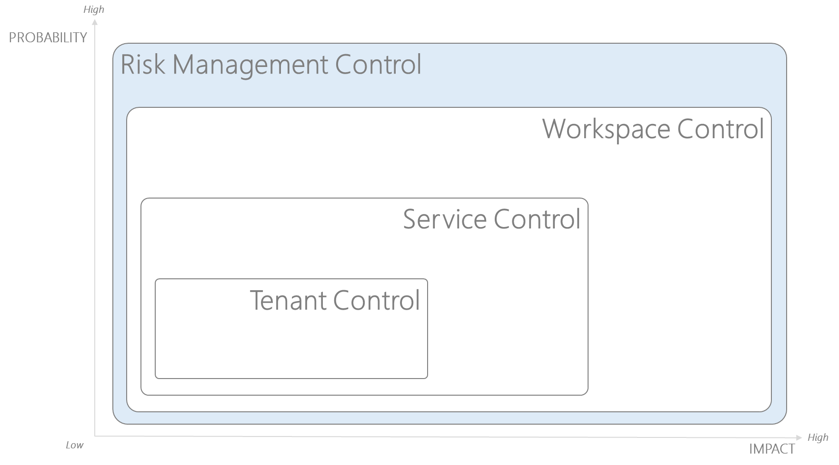
Cyber Risk Management Controls: Adaptive & Forward-Looking Investment In Risk Capability
Management Process for Identifying and Managing Existing & Emerging Threats That Result From Vulnerabilities
Continuous Improvement
Zero Trust, Assume Breach, Defence in Depth & Verify Everything
1
2
3
Threat Landscape
Under Management
Under Development
Emerging
Cyber Risk Controls
Articulation of Threat & Vulnerabilities
Control Coverage, Effectiveness & Expansion Capability
Vulnerability Surface Area
Inherent Probability
Residual Probability Objective
Cloud API Surface Versioning
Asset
Private DATA
Sensitive CODE
Population of actors that are likely to cause harm by deriving benefit from exploitable vulnerabilities
How Inherent Risk’s Are Consistently Identified, Mitigated & Measured
Level of Existing & Expanding Exposure, to the possibility of being attacked or harmed.
Ensure that existing and emerging information security vulnerabilities and threats pertaining to critical and sensitive information assets are identified, assessed and remediated in a timely manner CPG 234 (20)

Slide 12
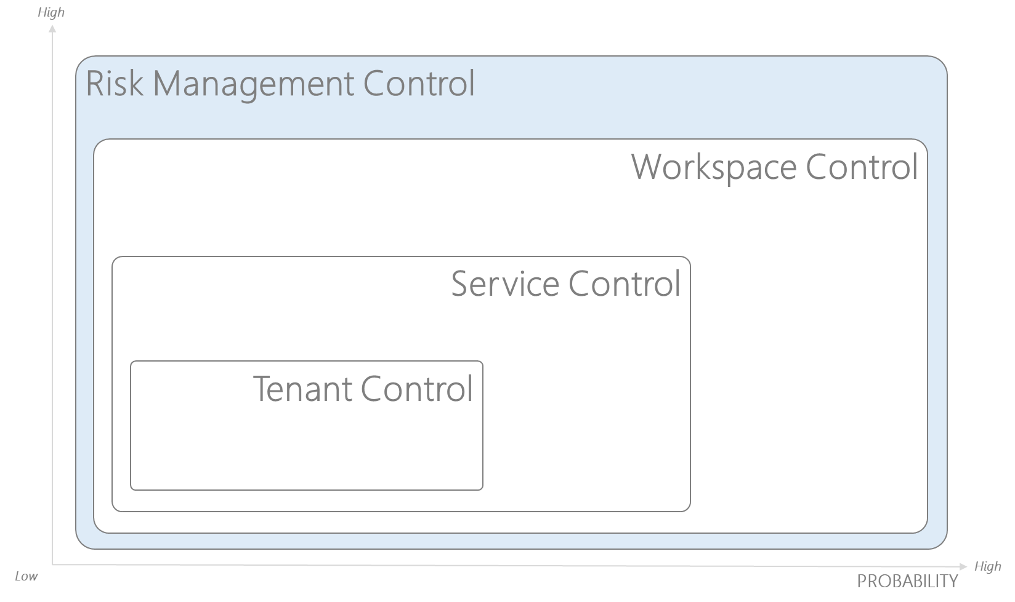
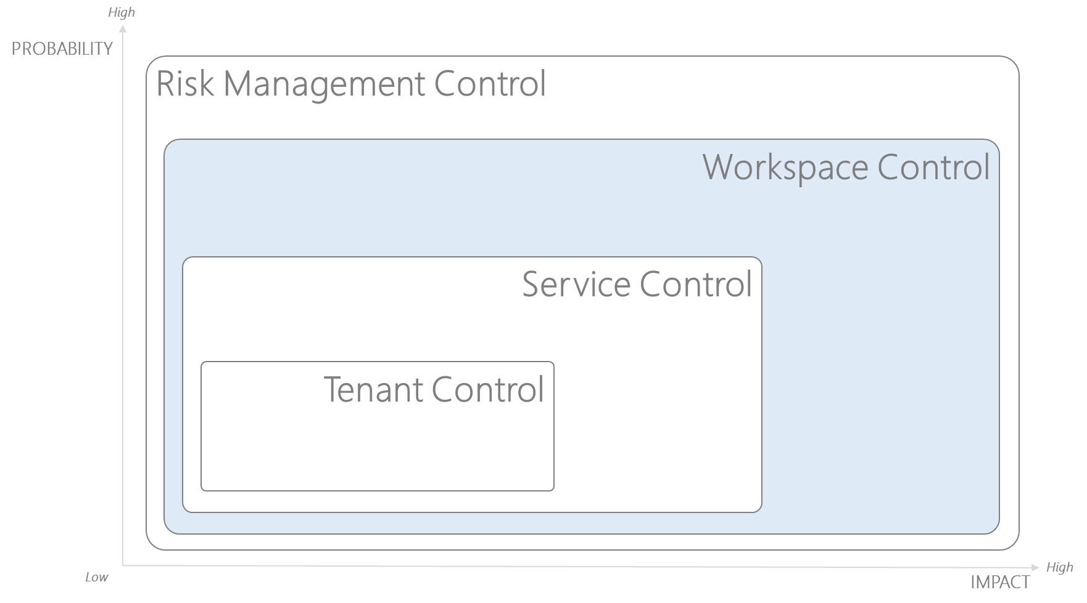
Workspace Controls: Maximising Group Wide Control Leverage
Logical Solution That Targets Specific Vulnerabilities That Are Best Solved At The Level Of The Workspace
Authorization Package
Segregation of Duty & Least Privilege
Fine Grained Scope (Change Boundary)
User & Automation Segregation
Control Plane & Secrets Segregation
Fault\Breach Isolation
Fine Grained Scope Boundary
Limit of Blast radius
Fail Safe mechanism
Extensible Scope
Inherent Logging, Monitoring & Alerting
Identity Lifecycle Governance
Conditions of Access
Authorization Attestation
Identity Accountability Reviews
JIT – Privilege Access Management
No Standing Elevated Privilege
Separation of Duty re: Privilege Activation
Workspace Creation Event
Instantiates a specific immutable version of workspace controls
Binds them to the Scope as declared in the workspace creation
Solves for the Highest Impact Vulnerabilities:
Identity Fraud (Authentication & Access)
Privileged Identity (malicious\accidental use of Authorization)
Containment of Breach (limiting the impact of a breach)
Change Integrity
Change Event Correlation with Pull Request, Work Items & Identity

Slide 13
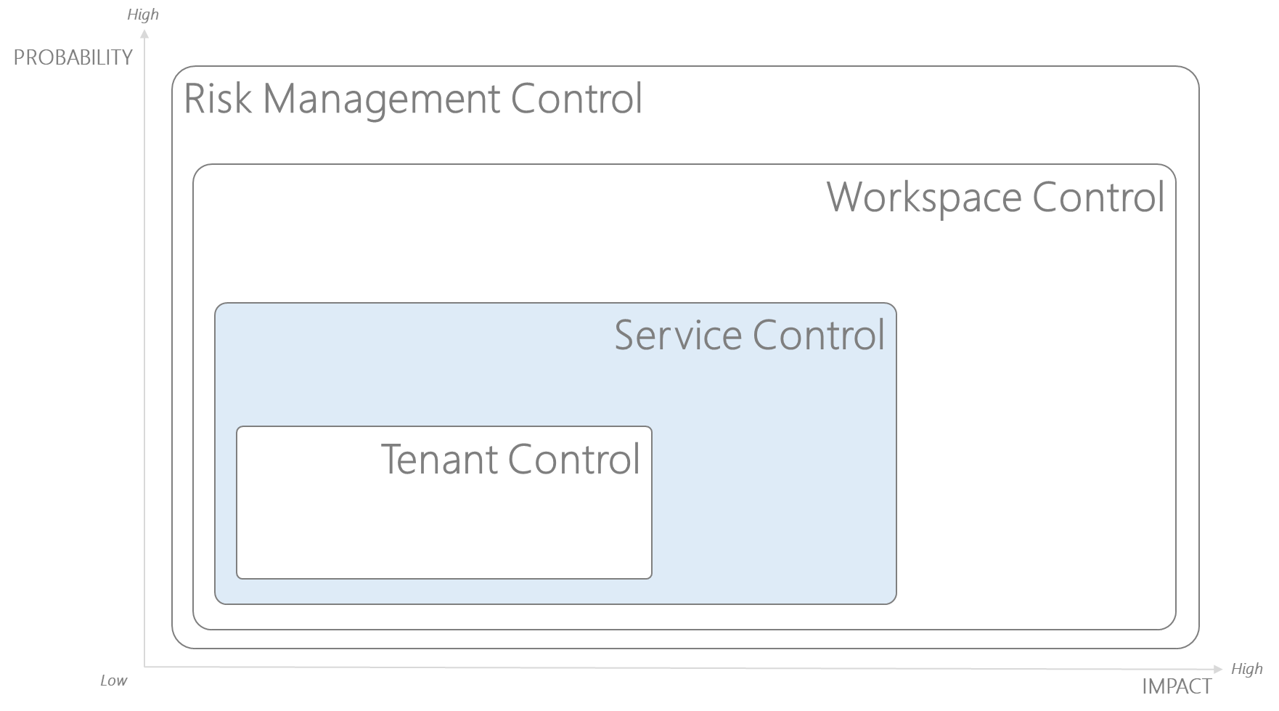
Service Controls: Consistent Scalable Control Model That Is Open To Inheritance
Logical Solution That Solves For The Specific Vulnerabilities That Remain Within The Workspace
Workspace Controls
Pre-runtime Control Plane & Data plane related Vulnerabilities are mitigated & Inherited via the Workspace Controls
Fault\Breach Isolation
Tenant is free to provision any Cloud Resource
Embedded controls will audit\prevent against a standard pattern
Encryption protects data confidentiality against vulnerabilities to:
Remote &
Physical exposure
Runtime Control\Data plane vulnerabilities are a function of:
Network Access Exposure &
Authentication to the Resource that hosts the Data\Code
Data Confidentiality through
encryption
Service networking via Addressable
Network
Range
At Rest
Public
In Use
In Motion
Private
Self Mgt
Sys Mgt
Tenant Freedom within Boundaries
Within the Fault\Breach Isolation boundary the tenant is free to use any Cloud Resource that is accessible
The Service based controls will consistently solve for the next level of commonly identified vulnerabilities:
Data confidentiality (encryption at rest\motion)
Data integrity (runtime data plane authentication)
Addressable Network Range (public\private address space)
Run-time Data Plane Authentication
Secret
Token

Slide 14
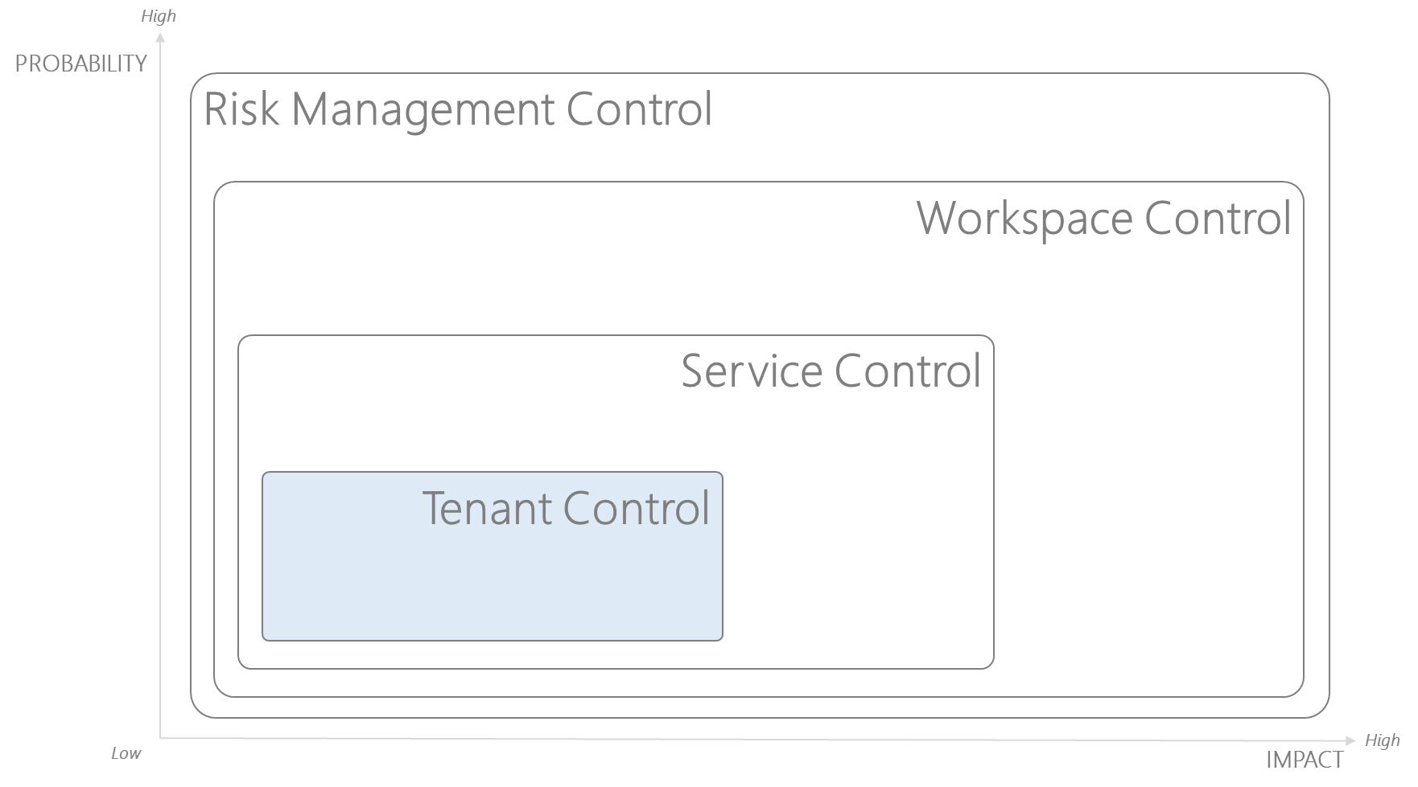
Tenant Controls: Consistent & Repeatable Operators for Known Tenant Level Vulnerabilities
Codifying Best Practice for Self Management Of Known Residual Vulnerabilities
Fault\Breach Isolation
The Tenant’s Residual Risk Position can be reduced further through the application of standard automated operators that solve for known vulnerabilities consistently
Secrets Management Operator
Change Integrity Operator
Vault Access Operator
Tenant Responsibility
The Tenant level controls relate to the following vulnerabilities that they are explicitly accountable for:
Secrets Lifecycle Management (Rotation, Access & Alerting)
Usage of Segregation of duty & Least Privilege controls
Service Networking Configuration Management (address space)
Change Integrity Verification (Correlation with CICD)
Just-In-Time PAM Operator

Slide 15
Enterprise Cloud: Threat Management Philosophy – Inherent Risk of Cloud
Within Cyberspace What is the Primary Value At Risk – Private & Sensitive Information
As an Enterprise there is a “Duty of care” or “Regulatory Requirement” to:
Asset
Preserve the Integrity, Confidentiality, Availability and Durability of Private Data
Private DATA
Sensitive CODE
Preserve the Integrity & confidentiality of code that interacts with and modifies sensitive data
Ensure that the functionality represented by the running instances of code are appropriately accessible, available and recoverable
Stakeholders including Boards of directors, senior management, shareholders, customers and regulators have heightened expectations for the effective safeguarding of Information Assets.
APRA CPG 234 – Information Security

Slide 16
Enterprise Cloud: Threat Management Philosophy – Cyber Resilience
A Posture of Anticipation, leaning into “Failure”, “Breach” & “Change”
Hardware will Degrade
Vulnerabilities will Exist
Software will have Bugs
Failure > 0%
Asset
Breach > 0%
Exploits will be Possible
Private DATA
People will make Mistakes
Sensitive CODE
People will be Motivated
Change Increases The Probability of
Change > 0%
Change Is both
Inevitable & Accelerating
Continuous OSS & Cloud Innovation → Change is both Inevitable & Accelerating

Slide 17
Enterprise Cloud: Threat Management Language – The Management of Probability
Establishing a Framework For Threat Management Dialogue
“THREAT”
“EXPOLIT”
“VULNERERABILITY”
“VALUE”
Asset
Person or Thing Likely to cause damage or danger
Ability to Make full use of and derive benefit from
Exposure to the possibility of being attacked or harmed
Value At Risk
Private DATA
Sensitive CODE
The Probability is Greater than 0%
The Probability is Greater than 0%
The Probability is Greater than 0%
The Probability is Greater than 0%

Slide 18

Enterprise Cloud: Risk Management Framework
Explicitly Managing the Probability of a Breach Occurring in Addition to The Impact Should a Breach Occur
Assume Breach HAS
Occurred
IMPACT
Inherent Risk
MITIGATE
IMPACT
Residual Risk
INSURE
Reducing IMPACT is a Function of Managing the Scope of the Blast Radius relating to a Breach
ACCEPT
Assume Breach COULD
Occur
Security Isolation\Scope
PROBABILITY
Identity
Authorization Management
Reducing PROBABILITY is a Function of Managing What People Can Do
PROBABILITY

Slide 19
Enterprise Cloud: Threat Model
Establishing the Threat Scenarios, Vectors & Dimensions
“THREAT SCENARIOS”
“THREAT VECTORS”
“THREAT DIMENSIONS”
“THREAT INSTANCES”
Assume Breach COULD
Occur
External Dependency
Runtime Data Plane
PROBABILITY
Security Isolation
Digital Value @ Risk
Physical
Security Isolation
Asset
Remote
AuthZN
Private DATA
IMPACT
Access
Sensitive CODE
Runtime
Pre-Runtime
AuthN
Change
Data Plane
Assume Breach HAS
Occurred
Control Plane

Slide 20

Enterprise Cloud: Closed Loop “Kernel State” Management
“Intentional Change & Placement” within a “Continuously Governed” and “Specifically Identifiable” Enterprise Cloud “Space”
Cloud Assurance Team
1
Continuous Governance of Space
Digital Business Service
Stack
Intentional Placement into Space
3
Control
CD
ENG
Service
Tenant Release Engineer
Stack
2
Intentional Placement into Space
Control
Service
Enterprise Cloud Native Platform
Cloud Control Team
0
Intentional Creation Of Space (s)

Slide 21
Enterprise Cloud: Closed Loop “Kernel State” Management
“Intentional Change & Placement” within a “Continuously Governed” and “Specifically Identifiable” Enterprise Cloud “Space”
Desired State
Operational State
Observed State
The Planning Process That Generates The Desired Objective Function
When & Where the Desired State Was Applied
The Measured Outcome Relative To The Desired Objective
correlate
Initialise
Change Approval
Tier, Stage & Cloud
Activity Detection
apply
detect
review
event
Interaction Metrics
Pull Request
event
Prediction Errors
event
Change Anomalies
build
Work Item
event
Runtime Metrics
event
Runtime Errors
commit
event
Team & Sprint
Consumption Metrics
event
Capacity Metrics
scope
event
Tier Backlog
Cyber Resilience Status
Predictive Modelling
train
prioritise
Backlog Grooming
prove
PRE-RUNTIME
RUNTIME
REAL-TIME

Slide 22
Enterprise Cloud: Closed Loop “Kernel State” Management
“Intentional Change & Placement” within a “Continuously Governed” and “Specifically Identifiable” Enterprise Cloud “Space”
Contain & Respond to a Security Breach
Cloud GRC Team
Detect & Accept an approved Emergency Change
Detect New Cloud Innovation or Poor Discipline
0
Continuous Governance of Space
Digital Business Service
Stack
Control
CD
ENG
Service
Release Engineer
Stack
Control
Service
Enterprise Cloud Native Platform
Cloud SRE Team
Any Unintentional Change
1

Slide 23
Enterprise Cloud: Pre-Runtime Preventative Threat Model Controls
Controls Designed to Reduce Both The Probability & Impact of Breaches
Assume Breach COULD
Occur
External Dependency
F
Physical
Remote
Pre-Runtime
Runtime
Authorization
A
Authentication
B
Access
C
PROBABILITY
Resource Control Plane
Resource Data Plane
Change Management
Security Isolation
E
D
App Runtime
Runtime Data Plane
IMPACT
Asset
Private DATA
Sensitive CODE
Assume Breach HAS
Occurred

Slide 24
Enterprise Cloud: Runtime Detective Threat Model Controls
Event Based Mechanism that Attaches To the Controls And Creates An Immutable Memory
Cloud GRC Team
External Dependency
F
Physical
Remote
Purpose: Continuous Assurance of Enterprise Governance, Risk & Compliance across all Cloud Usage
Pre-Runtime
Runtime
Authorization
A
Authentication
B
Access
C
Event Routing & Addressing
Resource Control Plane
Interaction Metrics
Resource Data Plane
Change Management
Security Isolation
E
D
App Runtime
Prediction Errors
Runtime Data Plane
Change Anomalies
Asset
Runtime Metrics
Private DATA
Runtime Errors
Sensitive CODE
Consumption Metrics
Capacity Metrics
Cyber Resilience Status

Slide 25
Enterprise Cloud: Runtime Control Perspective
The Ability To Reason Over The Effects Of Every Change or Interaction
Cloud GRC Team
Purpose: Continuous Assurance of Enterprise Governance, Risk & Compliance across all Cloud Usage
Zoom Out\In – to provide perspective at different levels of Scope (Spaces) over different intervals of Time
Who has privileged Auth (contributor\owner) – is it active or disabled by default?
Event Routing & Addressing
Who has interacted with this space within this time
Interaction Metrics
Is the Change Having the Impact that was Predicted?
Prediction Errors
Did they change any Control Plane or Data Plane State?
Change Anomalies
If So, was there an associated Chain of custody?
Runtime Metrics
Did this change affect the Runtime Metrics Trend
Runtime Errors
Did this change affect the Runtime Error Trend
Consumption Metrics
Did this change affect the Consumption Trend
Capacity Metrics
Are we reaching any Capacity Thresholds
Cyber Resilience Status

Slide 26
Enterprise Cloud: Runtime & Pre-Runtime – Resource Based – Cyber Resilience Posture
Cloud GRC Team
New Resource Provider
Private NW
New Resource Type
Public NW
Public
External Dependency
F
Physical
Private Registry
Remote
Purpose: Continuous Assurance of Enterprise Governance, Risk & Compliance across all Cloud Usage
Pre-Runtime
Runtime
Authorization
Pkg Version\Patch
Metrics
A
Authentication
Ctr Version\Patch
B
Access
Log Analytics
Telemetry
C
Event Routing & Addressing
OS Version\Patch
Resource Control Plane
Interaction Metrics
App Insights
Resource Data Plane
App Runtime
Prediction Errors
AAD
Runtime Data Plane
Change Anomalies
Asset
Secret
Credentials
Private DATA
Runtime Metrics
Runtime Errors
Cert
Sensitive CODE
Consumption Metrics
Rotation
Capacity Metrics
Has our Cyber Resilience Posture Changed
Vault
At Rest
Cyber Resilience Status
Encryption
In Motion
Key
In Use

Slide 27
Cloud Native Enterprise: Runtime & Pre-Runtime

